Slide 1
Sampling Distribution
Chapter 17 Means

Slide 2
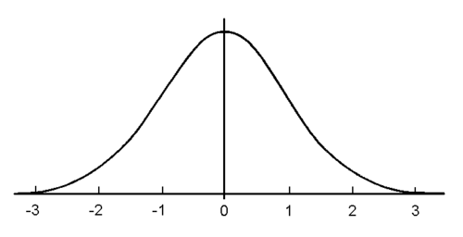
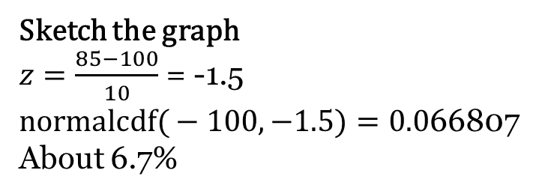
Last class we….
Calculate the probability that a person would have an IQ score of 85 or less given that the mean IQ is 100 and the standard deviation is 10.
Sketch the graph
$z=\frac{85−100}{10}$ = -1.5
$\text{normalcdf}\text{(}−100,−1.5)=0.0$66807
About 6.7%
Z-score
70
80
90
100
110
120
130
IQ score

Slide 3
What if we want…
Calculate the probability that 4 people would have an average IQ score of 85 or less given that the mean IQ is 100 and the standard deviation is 10.
We are now taking a sample and averaging the data from that sample. (ie Sampling Distribution)
To understand how our graph will be different, we need to understand about the Central Limit Theorem.

Slide 4
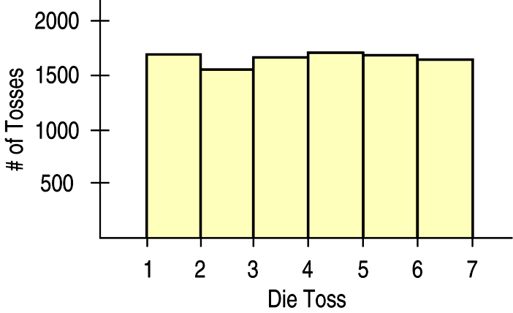
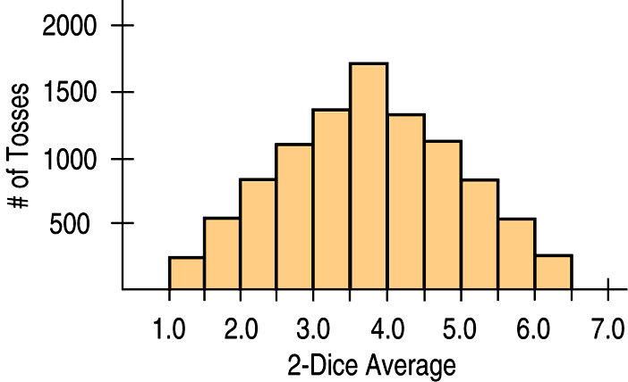
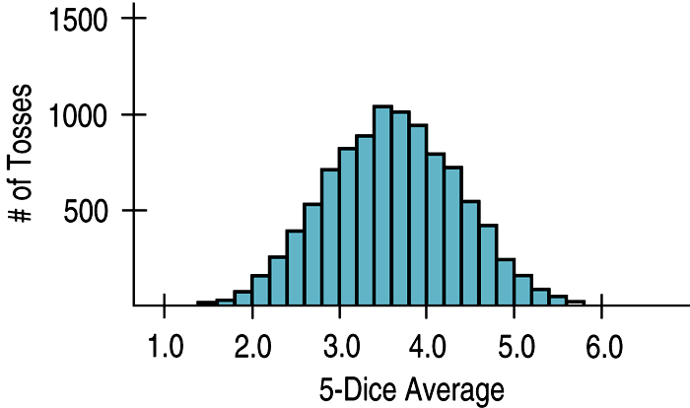
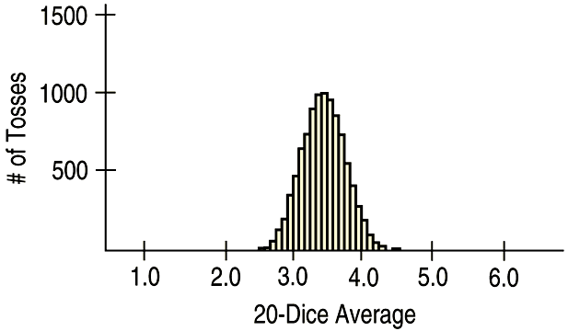
One die is tossed 10,000 times. Then 2-dice, 5-dice, and 20-dice are tossed 10,000 times and their averages are graphed below. What happens to the shape, center, and spread in the progression?

Slide 5
The previous exercise illustrates the Central Limit Theorem.
For larger and larger sample size n, we expect the Sampling Distribution’s
shape to become more Normal (unimodal and symmetric)
center to stay the same
spread to become smaller
How much smaller?
SD = $\frac{σ}{\sqrt{n}}$ where $σ=\text{standard} \text{deviation} \text{of} \text{the} \text{population}$

Slide 6
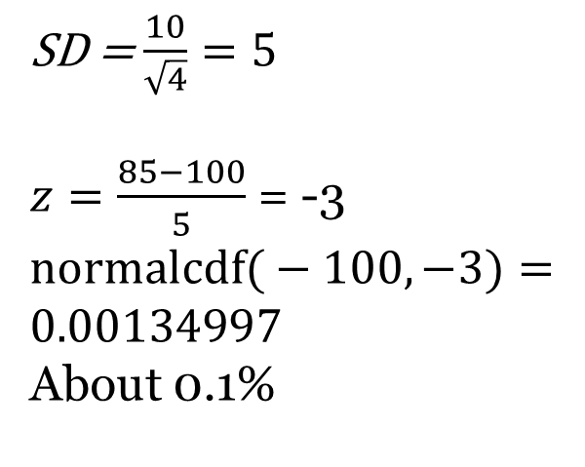
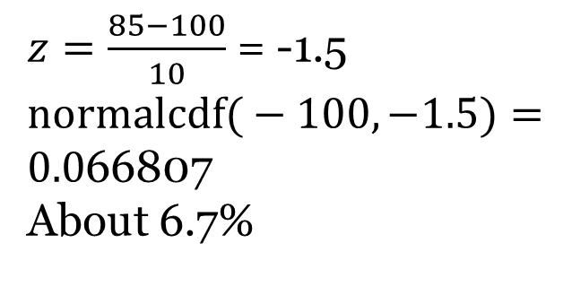
Given that the mean IQ is 100 and the standard deviation is 10.
Calculate the probability that a person would have an IQ score of 85 or less.
Calculate the probability that 4 people would have an average IQ score of 85 or less.
SD = $\frac{10}{\sqrt{4}}=5$
$z=\frac{85−100}{5}$ = -3
$$\text{normalcdf}\text{(}−100,−3)=$$
$$0.00134997$$
About 0.1%
$z=\frac{85−100}{10}$ = -1.5
$$\text{normalcdf}\text{(}−100,−1.5)=$$
$0.0$66807
About 6.7%

Slide 7
When does the Central Limit Theorem work?
Independence Assumption: The sampled values must be independent of each other.
Randomization Condition: The data values must be sampled randomly.
10% Condition: When the sample is drawn without replacement, the sample size, n, should be no more than 10% of the population.
Sample Size Assumption: The sample size must be sufficiently large.

Slide 8
Try this
Carbon monoxide (CO) emissions for a certain kind of car vary with a mean 2.9 g/mi and standard deviation 0.4 g/mi.
What is the probability that one car has a CO emission between 3.0 and 3.1 g/mi? Draw a sketch. (Ans 9.3%)
What is the probability that the mean of 80 cars has a CO emission between 3.0 and 3.1 g/mi? Draw a sketch.
(Ans 1.3%)

